Slide 1







SENTIMENT ANALYSIS
Problem Statement
TO DEVELOP AN AI MODEL TO UNDERSTAND THE SENTIMENTS ABOUT THE COMPANY USING SOCIAL MEDIA FEEDS SUCH AS TWITTER, FACEBOOK, LINKEDIN AND OTHER DIGITAL MEDIA INPUTS
WHAT IS IT?
ALSO KNOWN AS OPINION MINING
NATURAL LANGUAGE PROCESSING TECHNIQUE USED TO ANALYZE TEXT DATA FOR POSITIVE ,NEGATIVE OR NEUTRAL SENTIMENTS
UTILITIES
ENHANCE PRODUCTS BY ANALYZING FEEDBACK
PRIORITIZE FEATURES FOR EFFECTIVE IMPROVEMENTS
PERCEIVE, IDENTIFY CRISES, AND MANAGE REPUTATION PROACTIVELY.

Slide 2


PLAN OF ACTION
- APPROACH: Scraped airline tweets dataset and cleaned data.
- SPLIT: Utilized an 80%:20% Training-Validation Split for modeltraining.- -MODEL : Fine-tuned a Roberta-Base model, freezing all layers except classification projection head.
- PROJECTION LAYERS: Employed 2 hidden layers: first projecting 768- dimensional vector to another 768-dimensional vector, and second projecting to a 3-dimensional output vector.
- OBJECTIVE: Achieved streamlined processing and effective classification for airline tweet sentiment analysis.

Slide 3
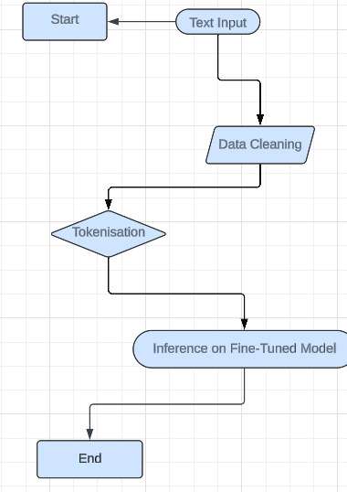
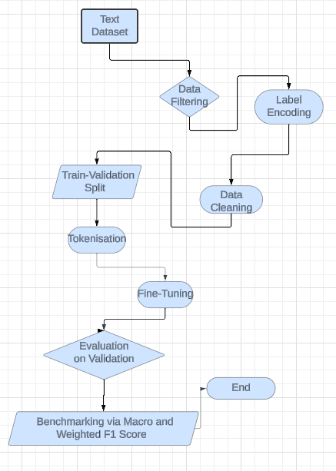

TECHSTACKS USED:
Python Version 3.10.0
numpy==1.26.3
pandas==2.2.0
scikit-learn==1.4.0
tqdm==4.66.1
torch==2.2.1
transformers==4.37.2
INFERENCE FLOWCHART
TRAINING FLOWCHART
TECHNICAL SPECIFICATIONS
- Training Settings:
- Optimizer: AdamW
- Learning Rate (LR): 2e-3
- Scheduler: ReduceLROnPlateau
- Early Stopping: Triggered after 7 epochs of no improvement
- Evaluation Metrics:
- Model Evaluation: Performed on the validation dataset
- Labels: Negative, Neutral, Positive Review
- Metrics Used: Macro F1 and Weighted F1
PRESENTED BY --
SANDEEP CHILWAL
NISHA KUMARI
KAVYA SHARMA

